Slide 1

LEXER AND PARCER
Boolean Expression
Kyle Engreso

Slide 2
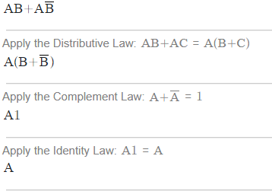
Example
(A & B) | (A & ~B)
Answer: A

Slide 3
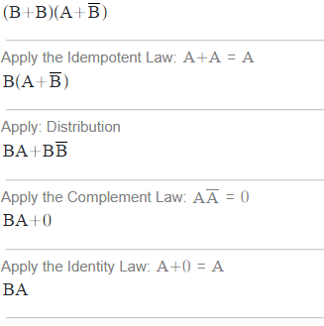
Example
(B|B)&(A|~B)
Answer: B & A

Slide 4
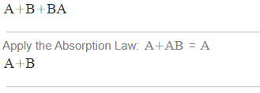
Example
(A | B)|(B & A)
Answer: B & A

